Slide 1



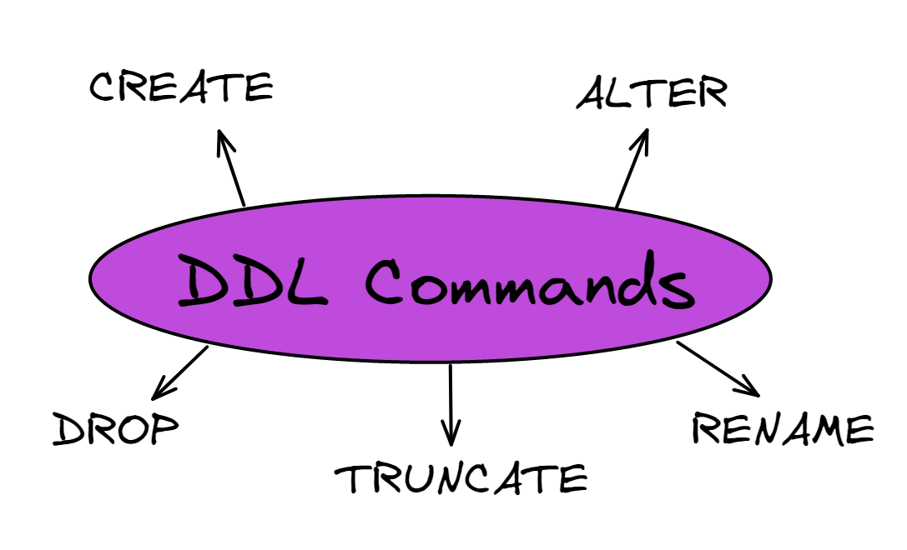
C. U. SHAH (GOVT) POLYTECHNIC
SURENDRANAGAR
COMPUTER ENGINEERING DEPARTMENT
DDL COMMANDS (DATA DEFINITION LANGUAGE)
Create:- Create command used to create the new table.
→Syntax:-
[CREATE TABLE table_name(column_name datatype(size));]
Alter:- Alter command is used to add, delete or modify structure.
→ Syntax:-
[ALTER TABLE table_name(drop column column_name);]
Truncate:- Truncate command is used to erase of the records table.
→ Syntax:-
[TRUNCATE table table_name;]
Drop:- Drop command is used to delete table in database object.
→ Syntax:-
[DROP table table_name;]
Rename:-Rename command is used to change table and column
name.
→ Syntax:-
[RENAME table_name to new table_name;]
→ Syntax:-
[Alter table table_name
RENAME column_name to new column_name;]
Database languages are used to read data, update and store information in Dbms.
Prepared By :-
Mandaliya akshar (226090307073)
Mandaliya om (226090307083)
Pipaliya akshay (226090307107)
Guided By :-
MR.U.N.PARMAR
(Lecturer – Computer Engg. Dept.)

